Slide 1
Junior data engineer project
Twitter API
Group 4 : Ian Johnson Vincy 28 Oct 2021

Slide 2
Content
Introduction
Idea
Let’s start!
ER-diagram
Database Design
Our Program
What we learn (hard skills & soft skills)
Resource

Slide 3
Introduction
Create Twitter API keys to use in an application
Use tweepy and other tools in Python
Collect user:@JoeBiden profile information , social network information from Twitter
Use the following two keywords( coronavirus, vaccination) to collect tweets
Database design

Slide 4
Idea
General background Information
Purpose
Gather information
Method( soft ware, tools)

Slide 5
Let’s start !

Slide 6
Apply for Twitter developer account & get authentication
Create a twitter account at twitter.com
Use consumer key and access taken
consumer_key | = | 'ABCDEFGHIJKLKMNOPQRSTUVWXYZ'
consumer_secret | = | '1234567890ABCDEFGHIJKLMNOPQRSTUVXYZ'
access_token | = | 'ZYXWVUTSRQPONMLKJIHFEDCBA'
access_token_secret | = | '0987654321ZYXWVUTSRQPONMLKJIHFEDCBA'

Slide 7
Start to crawler the twitter API data
Python
Sqlite3
Tweepy

Slide 8
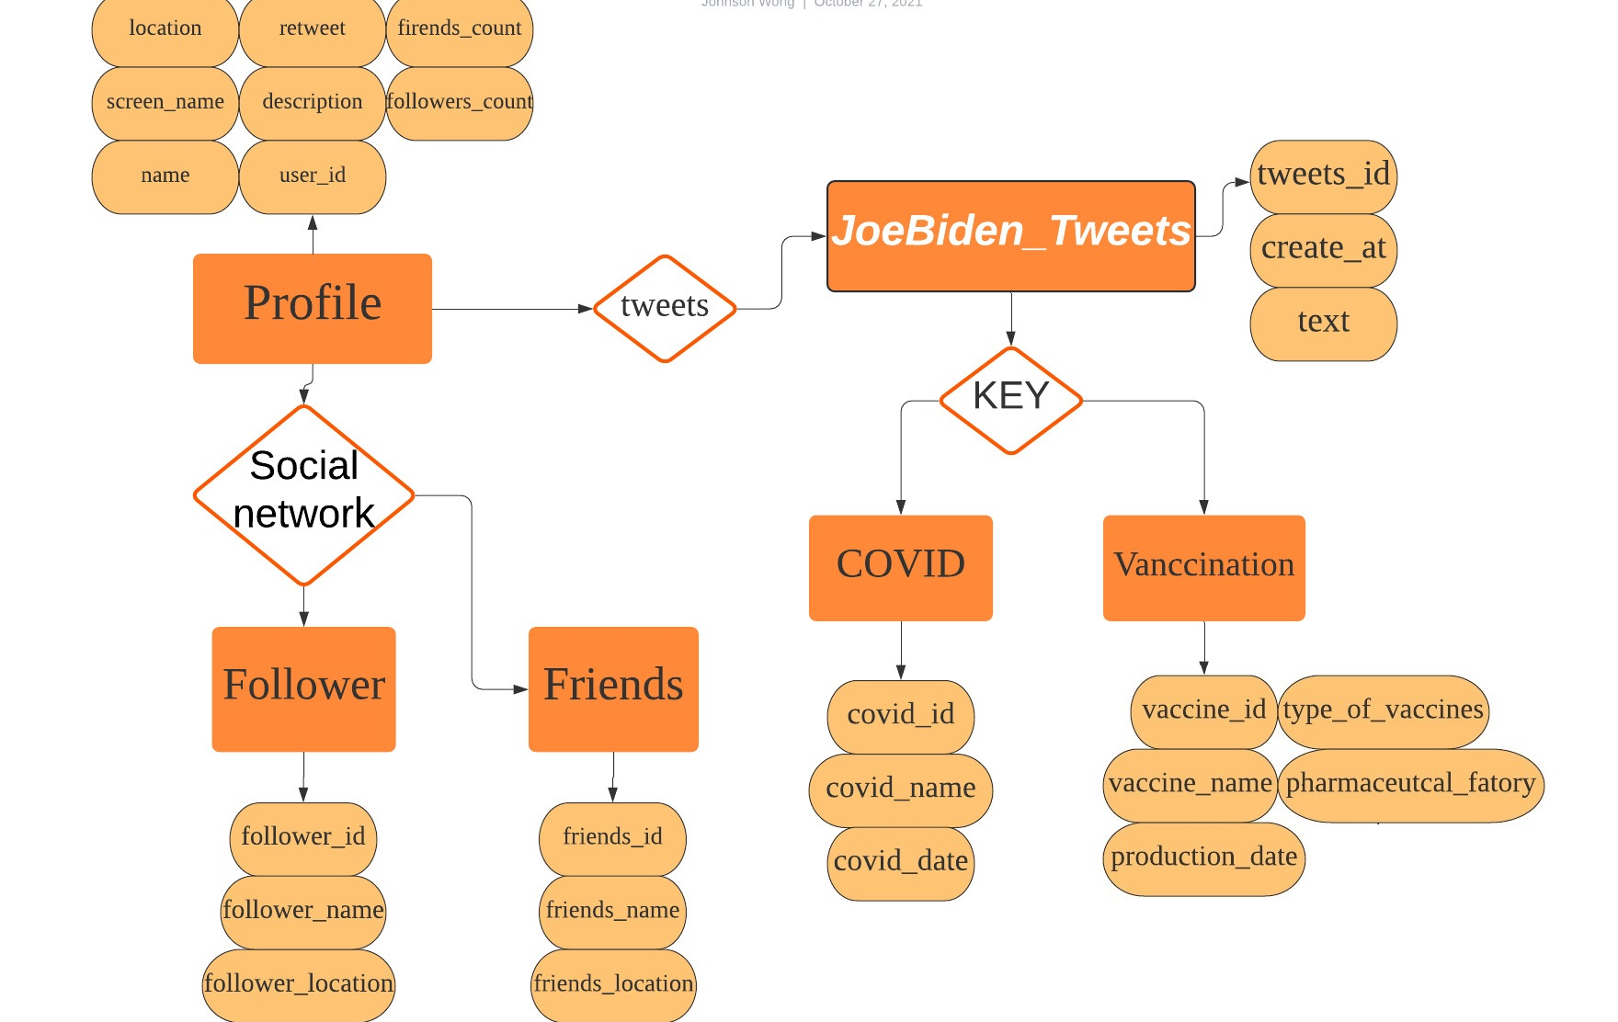
ER-Diagram
説明

Slide 9
Database design

Slide 10
Our program

Slide 11
Challenge & Problems
Lack of clear goals and success criteria
Finding the right resource
Inadequate skills of team members
Lack of communication

Slide 12
What we learn
Hard Skills (technical skills)
ETL(stands for extract, transform, load)
Create the pipeline
Use programming language and tools(Python, SQLite……)

Slide 13
Soft Skills (non-Technical skills)
Communication
Teamwork (Cooperation)
Time Management
Positivity
Problem-solving

Slide 14
Resource
https://towardsdatascience.com/tweepy-for-beginners-24baf21f2c25
https://developer.twitter.com/en/docs/twitter-api/v1/accounts-and-users/follow-search-get-users/overview
https://medium.com/geekculture/how-to-get-twitter-data-with-tweepy-4663fbc8b90b
https://stackoverflow.com/questions/3128323/get-current-users-info-from-twitter-api#

Slide 15
Thank you for listening!!

